Slide 1

Selected Topics in Computational Intelligence I
Session 4
Particle Swarm Optimization

Slide 2
Agenda
Introduction
Global best and local best
Social Network Structures

Slide 3
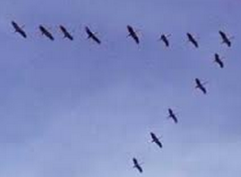
Introduction
Particle Swarm Optimization (PSO) is a biologically inspired computational search and optimization method developed in 1995 by Eberhart and Kennedy based on the social behaviors of birds flocking or fish schooling.

Slide 4
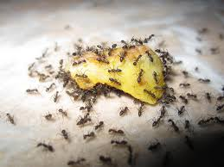
Flocking
The flocks achieve their best condition simultaneously through communication among members who already have a better situation.
Animal which has a better condition will inform it to its flocks and the others will move simultaneously to that place.

Slide 5
PSO
The particle swarm optimization (PSO) algorithm: population-based search algorithm based on the simulation of the social behavior of birds within a flock.
In PSO, individuals, referred to as particles, are “flown” through hyper dimensional search space.
The initial intent of the particle swarm concept was to graphically simulate the graceful and unpredictable choreography of a bird flock

Slide 6
Best Solution
Each particle keeps track of its coordinates in the solution space which are associated with the best solution (fitness) that has achieved so far by that particle. This value is called personal best , pbest.
Another best value that is tracked by the PSO is the best value obtained so far by any particle in the neighborhood of that particle. This value is called gbest.
The basic concept of PSO lies in accelerating each particle toward its pbest and the gbest locations, with a random weighted acceleration at each time step as shown

Slide 7
Best Solution
y
x
Concept of modification of a searching point by PSO
s^{k} : current searching point. s^{k+1}: modified searching point. v^{k}: current velocity. v^{k+1}: modified velocity. v_{pbest} : velocity based on pbest. v_{gbest} : velocity based on gbest

Slide 8
PSO Algorithm
PSO Algorithm
Start
Initialize particles with random position
and velocity vectors.
For each particle’s position (p)
evaluate fitness
Loop until all particles exhaust
If fitness(p) better than
fitness(pbest) then pbest= p
Loop until max iter
Set best of pBests as gBest
Update particles velocity (eq. 1) and
position (eq. 3)
Stop: giving gBest, optimal solution.

Slide 9
Basic PSO
Individuals : to emulate the success of neighboring individuals and their own successes.
The collective behavior that emerges from this simple behavior is that of discovering optimal regions of a high dimensional search space.
A PSO algorithm maintains a swarm of particles, where each particle represents a potential solution.

Slide 10

Basic PSO
A swarm is similar to a population, while a particle is similar to an individual. The particles are “flown” through a multidimensional search space, where the position of each particle is adjusted according to its own experience and that of its neighbors.
Let x_{i}(t) denote the position of particle i in the search space at time step t; unless otherwise stated, t denotes discrete time steps. The position of the particle is changed by adding a velocity, v_{i}(t), to the current position

Slide 11
Global Best PSO
For the global best PSO, or gbest PSO, the neighborhood for each particle is the entire swarm. The social network employed by the gbest PSO reflects the star topology
where v_{ij}(t) is the velocity of particle i in dimension j = 1, . . . , n_{x} at time step t, x_{ij}(t) is the position of particle i in dimension j at time step t, c₁ and c₂ are positive acceleration constants used to scale the contribution of the cognitive and social components respectively

Slide 12
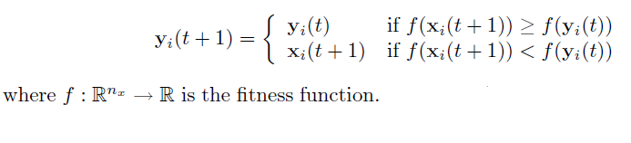
Global Best PSO
The personal best position, y_{i}, associated with particle i is the best position the particle has visited since the first time step. Considering minimization problems, the personal best position at the next time step, t + 1, is calculated as

Slide 13


Global Best PSO
The global best position, , at time step t, is defined as
The global best position can also be selected from the particles of the current swarm, in which case

Slide 14
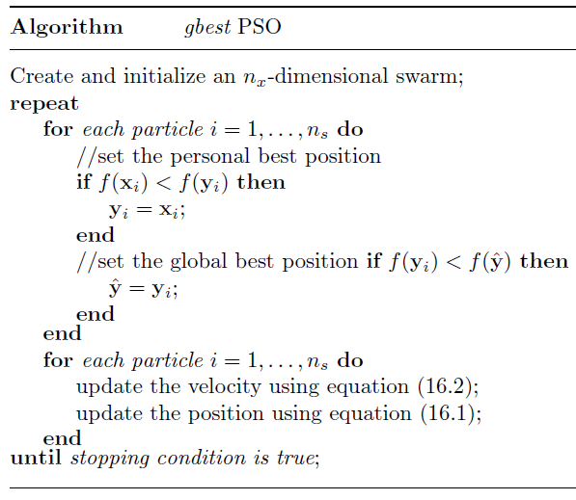
gbest PSO algorithm
The gbest PSO is summarized

Slide 15
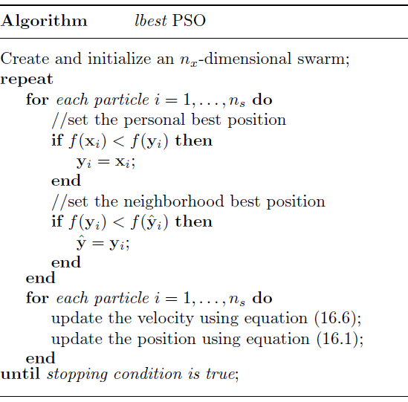
lbest PSO Algorithm

Slide 16
Comparison
Due to the larger particle interconnectivity of the gbest PSO, it converges faster than the lbest PSO. However, this faster convergence comes at the cost of less diversity than the lbest PSO.
As a consequence of its larger diversity (which results in larger parts of the search space being covered), the lbest PSO is less susceptible to being trapped in local minima. In general (depending on the problem), neighborhood structures such as the ring topology used in lbest PSO improves performance

Slide 17

Velocity Components
The previous velocity, which serves as a memory of the previous flight direction, i.e. movement in the immediate past. This memory term can be seen as a momentum, which prevents the particle from drastically changing direction, and to bias towards the current direction. This component is also referred to as the inertia component.

Slide 18
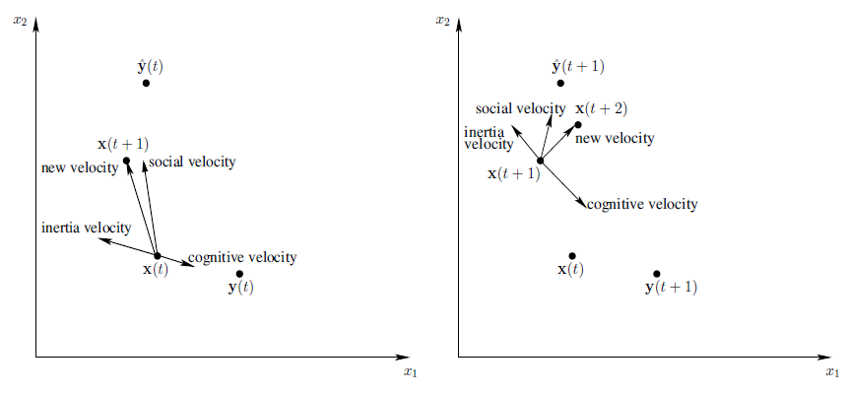
Geometrical illustration
Geometrical Illustration of Velocity and Position Updates for a Single Two-Dimensional Particle

Slide 19
Social Network Structures
The feature that drives PSO is social interaction. Particles within the swarm learn from each other and, on the basis of the knowledge obtained, move to become more similar to their “better” neighbors. The social structure for PSO is determined by the formation of overlapping neighborhoods, where particles within a neighborhood influence one another.
This is in analogy with observations of animal behavior, where an organism is most likely to be influenced by others in its neighborhood, and where organisms that are more successful will have a greater influence on members of the neighborhood than the less successful.

Slide 20
Social Network Structures
Within the PSO, particles in the same neighborhood communicate with one another by exchanging information about the success of each particle in that neighborhood.
All particles then move towards some quantification of what is believed to be a better position. The performance of the PSO depends strongly on the structure of the social network.

Slide 21
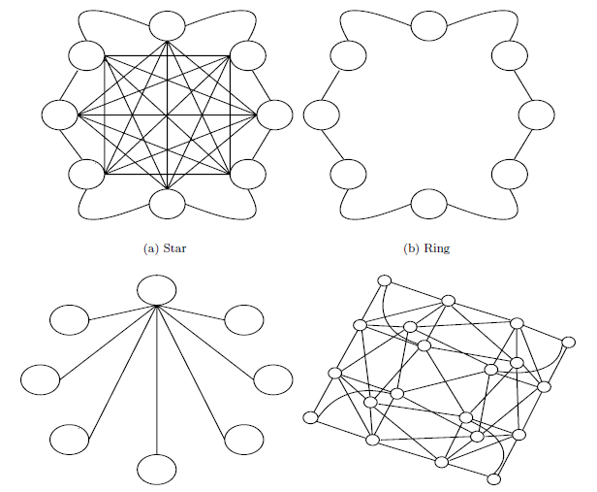
Social Network Structures

Slide 22
Social Network Structures
Different social network structures have been developed for PSO and empirically studied.
The star social structure, where all particles are interconnected as illustrated in Figure (a). Each particle can therefore communicate with every other particle. In this case each particle is attracted towards the best solution found by the entire swarm.
The ring social structure, where each particle communicates with its n_{N} immediate neighbors. In the case of n_{N} = 2, a particle communicates with its immediately adjacent neighbors as illustrated in Figure (b). Each particle attempts to imitate its best neighbor by moving closer to the best solution found within the neighborhood.

Slide 23
References
Andries P. Engelbrect. (2007), Computational Intelligence An Introduction. 2nd Ed. John Wiley & Sons. USA. ISBN: 978-0-470-03561-0
James M. Keller, Derong Liu, David B. Fogel (2016). Fundamentals of Computational Intelligence. Neural Networks, Fuzzy Systems and Evolutionary Computation, Wiley ISBN 978-1-110-21434-2
Bansal, Jagdish Chand, Pramod Kumar Singh, and Nikhil R. Pal . (2017) "Evolutionary and Swarm Intelligence Algorithms", Springer, ISBN 978-3-319-91339-1
Bernhard, Korte, and J. Vygen (2008), "Combinatorial optimization: Theory and algorithms." Springer, Third Edition.

Slide 24
Thank You

